Slide 1

A Deeper Dive into the Model for Improvement--Why We Use It
Sue Butts-Dion, Improvement Advisor
October 30, 2015

Slide 2
Aim
Participants leave session with:
  Ideas for ways to identify improvement opportunities that will improve quality & safety
  Better understanding of the elements of the Model for Improvement and how to use the Plan-Do-Study-Act cycles to “learn their way to implementation”
  Clarification of “testing”
  New ideas to apply to existing and/or new improvement projects

Slide 3
Before we begin with Model for Improvement…
We know a lot about what can be done to improve quality & safety and to reduce harm…
No loss for things to do.
Improved referral and follow processes
Improved care transitions and handoffs
Medication management
Improved systems for communications
Efficient use of EHRs
Etc, etc.

Slide 4
Alignment around definition of quality
Quality Definition
How does your team define quality?
The Quality Chasm report described broad quality issues and defined six aims. Care should be:
  Safe
  Effective
  Patient-centered
  Timely
  Efficient
  Equitable
If you haven’t defined quality, how might you plan to have this important discussion?
If you have defined quality, how are you communicating that widely so that all are aligned?
  http://iom.nationalacademies.org/Global/News%20Announcements/Crossing-the-Quality-Chasm-The-IOM-Health-Care-Quality-Initiative.aspx#sthash.f59Mn89A.dpuf

Slide 5

Baseline Assessment
  The things that “keep you up at night” are great places to start your work.
  Then dig a little deeper to see if there are things that should be “keeping you awake” at night☺
Notes:
It can be what keeps you up at night and…

Slide 6
Baseline Assessments
Some Favorites
  Clinical data
  Patient survey results
  Patient Centered Medical Home (NCQA) criteria
  Office systems surveys (e.g., AHRQ Medical Office System of Patient Safety Culture), Assessment of Chronic Illness Care, Clinical Microsystems 5 Ps for Outpatient Primary and Specialty Care)
References
http://www.ncqa.org/Programs/Recognition/Practices/PatientCenteredMedicalHomePCMH.aspx
http://www.ahrq.gov/professionals/quality-patient-safety/patientsafetyculture/medical-office/userguide/medoffitems.html
http://www.improvingchroniccare.org/index.php?p=ACIC_Survey&s=35
https://clinicalmicrosystem.org/workbooks/
Notes:
It can be what keeps you up at night and…

Slide 7
Considerations
Have you defined quality in your practice?
When and how did you last assess current environment as it relates to quality and safety?
From this assessment, what did you learn that would influence your quality improvement efforts?
If you have not done a recent assessment, how might you attempt that task?

Slide 8

“Why” use the Model for Improvement?

Slide 9
Why use the Model for Improvement? (Copyright: Associates in Process Improvement)

Slide 10
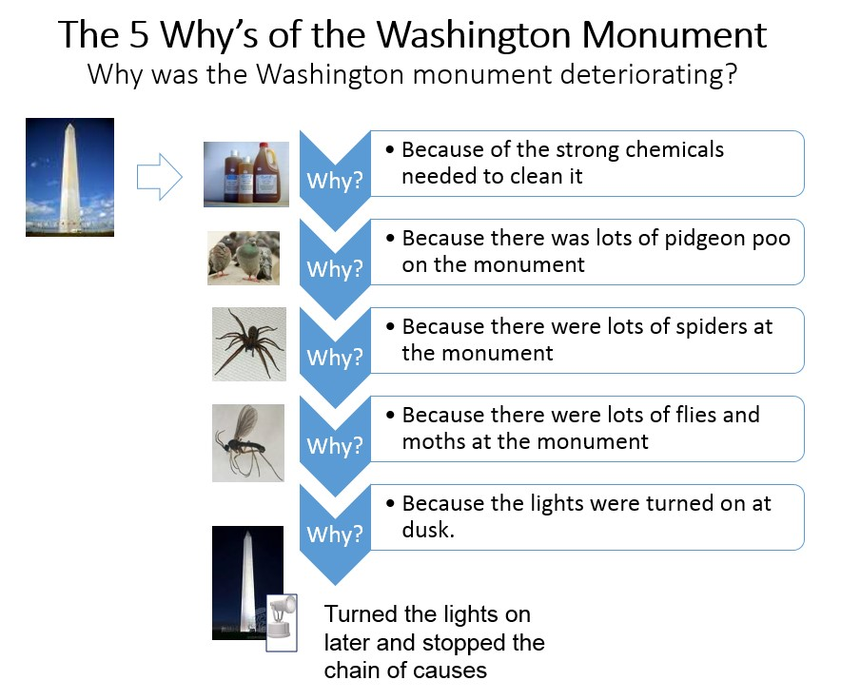
Source: http://www.rch.org.au/uploadedImages/Main/Content/quality/Washington%20Monument.jpg
Notes:
Example of exercise to help determine root cause.
(Can give example of something from their unit.)

Slide 11
Why?
Because it has been proven effective in helping accelerate change and improvement in healthcare.
Because change and transformation does not happen because of hard work, education and vigilance alone.
Provides a structured way for us to “learn our through improvement and to implementation” via interventions that are designed and tested iteratively.
Keeps us focused on “bad systems” and NOT bad “people”.
Encourages frequent and ongoing measurement to guide our work.

Slide 12

Debrief:
What did we learn?
Goals & Measures?
Teams and motivation?
PDSA Cycles—Small Tests of Change

Slide 13
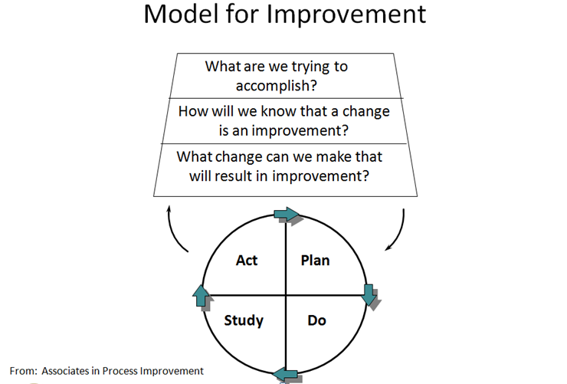
How have we learned that we can accelerate change and increase improvements in healthcare?
The Model for Improvement is a framework intended to guide improvement by helping teams & individuals:
Know what it is they need to improve.
Have a feedback mechanism in place to tell how they are doing.
Develop changes to test. And test them on a small scale before implementing.

Slide 14
Model For Improvement
3 Approaches
Standardization
Incremental Improvement
Innovation
  W. E. Deming (attributed)
Robust In Scale
Small QI
Large QI
And anywhere in between!
Notes:
The reason we use the MFI is because it is a simple yet powerful way to guide our improvement efforts. For example, we can use it to guide improvement whether we are standardizing, incrementally improving, or innovating! And we can use it to think about a range of improvement projects including small QI projects (departmental improvement), large QI projects (strategic planning projects at the hospital level) and anywhere in between!

Slide 16

Question 1: What Are We Trying to Accomplish?
Aim statement:
  What?
  For whom?
  By when?
  How much?

Slide 17
Why?
Traits of High Performing Teams
  Clear roles and responsibilities
  A clear, valued and shared vision
  Optimize resources
  Strong team leadership
  Provide regular feedback
  Develop a strong sense of collective trust, team identity and confidence
  Create mechanisms to cooperate, coordinate and generate ongoing collaboration
  Manage and optimize performance outcomes
TeamSTEPPS

Slide 18
What are We Trying To Accomplish?
The AIM is
Not just a vague desire to do better
A commitment to achieve measured improvement
  In a specific system
  With a definite timeline
  And numeric goals
18
Notes:
18

Slide 19

Smart AIMS
SMART aims
  Specific
  Measureable
  Achievable
  Realistic
  Time bound

Slide 20
Examples…
From…
To…
Improve our FOBT return rates.
Between October 2015 and July 4th, 2016, improve our FOBT return rates to 60% (currently at median of 15% return rate). We will accomplish this by focusing on:
  Refining calendar for reminder letter and phone list generation to improve efficiency and return rates
  Develop and implement promotion strategy to increase uptake of FOBT screen
  Focused education strategy with patients and with staff

Slide 21
Examples…
From…
To…
Reduce % readmissions w/in 30 days (Primary care practice).
Between October 2015 and July 4th, 2016, participate in a quality improvement (QI) collaborative to decrease potentially avoidable 30-day hospital all cause readmissions by 5% (This equates to approximately 2 fewer patients from our practice each month being readmitted.)

Slide 22
Examples…
From…
To…
Reduce the time that it takes for us to follow up with patients on abnormal test results.
By January 1st, 2016, it will be documented that 90% of our patients with abnormal test results were contacted about their results w/in 24 hours of receipt from the lab and a plan in place for follow up to those results.

Slide 23
Your Project Aim? (See worksheet.)
SMART aims
  Specific
  Measureable
  Achievable
  Realistic
  Time bound

Slide 25

Outcome measures
Process measures
Structural measures (if useful)
Balancing measures (if useful)
Notes:
Objective: Introduce concept of three (3) types of measures for improvement and use of a balanced set of these measures for all improvement efforts COVER THE AIM
Explanation: Improvement measures can fall into three areas: Outcome measures: Process Measures and Balance measures. Using three different views to see a better picture of the project.
Bridge to next slide: Lets look at each measure in more detail

Slide 26
Examples of Measures for Improvement Projects
Increasing FOBT Return Rates
Outcome
  Overall FOBT return rate
Process
  Percent of patients with reminder calls returning FOBT.
  Percent charts with documentation that patient received and understood instructions for FOBT.
Structure
  Availability of convenient way to get FOBT returned to the practice.
  FOBT covered by insurance.
Balancing
  Length of office visits.
  Patient satisfaction.

Slide 27
Examples of Measures for Improvement Projects
Primary Care Practice Collaborative to Reduce Readmissions
Structure
  Availability of alternative services to provide care (home health, extended practice hours, community care teams, etc.).
  Availability of transportation services for patients to get to f/u appointments.
  % of patients with phones—reliable ways to be reached.
  Practice teams participating in all interventions of the collaborative (phone calls, meetings, etc.)
  Collaborative faculty assessment.
Balancing
  Cost to staff extended and weekend hours.
  Staff capacity/burn out.
  Length of office visits.
Outcome
  % of patients with same cause readmissions to the hospital w/in 30 days
Process
  % of patients d/c from hospital with call w/in 48 hours of d/c.
  % of patients seen in office w/in 7 days of d/c.
  % of patients with medication reconciliation done during office visit.
  % of patients informed of how to access emergency care services (other than hospital admission) if need be.

Slide 28
Examples of Measures for Improvement Projects
Reduce time for f/u to abnormal test results
Outcome
  % of patients with abnormal test results where documented contact w/in 24 hours of receipt of test result
  % of patients with documented f/u plan
Process
  Turnaround time from time the lab sends test results until time seen by a provider who can take action
  Average number of calls that need to be made to contact patient
Structure
  Call scheduling system in place.
  Access.
  Appropriate notification time parameters defined.
Balancing
  Patient satisfaction.

Slide 29
Measures for Improvement
  Measures are used to bring new knowledge into daily practice
  Measures tell a story; goals give a reference point
  In improvement we need “just enough” data to learn and inform the next change/test/PDSA
  Plot data over time--tracking a few key measures over time is the single most powerful tool a team can use

Slide 30
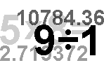

Qualitative & Quantitative
Sources
  Patient experience/satisfaction surveys
  Employee satisfaction surveys
  Solicited and unsolicited data - complaints, letters, cards, stories
  Interviews, focus groups
  Observation
+

Slide 31
Measures for Your Project?

Slide 33
Many Places to Find Changes to Test
Research
Evidence/Literature
Experience
Hunches/Ideas/Theories
From Others
Results of Assessment Using Improvement Tools (e.g., Flowcharts/flow maps)
Generic Change Concepts (The Improvement Guide 2nd Edition, pgs 357-408)

Slide 34
Flow charts—One Great Tool for Displaying and Analyzing Processes--Breaking Down the Complexity
High Level (top-down or block diagram)
Detail Level (flow chart – several types including value added flow charting)

Slide 35
High-Level Diagram
Simplest form of process description. Will help establish boundaries for the process, identify internal customer, and foster conversation.
  Identify the major process segments (usually done horizontally so information can be hung below the major process steps)
  Write them in the order they occur
    If there are more than 8 segments the process might be too large—narrow down

Slide 36
Block Diagram—Test Results (Exercise)
Patient checks in
Patient seen by provider
Lab test(s) ordered
Test(s) done and results shared
F/u on abnormal results
Results shared as needed
Step 2: Hang specific steps
related to the bigger
“buckets” of work
underneath appropriate step, vertically
Notes:
No decision points
Identify segmentation of process and internal customer supplier relationships
Individual flowcharts are nested behind each block
Each block represents a major segment of the process
Just to get the lay of the land
Help to decide where to start and the level of detail needed to continue
Useful to identify block where further specificity is needed, without having to flowchart everything. Be certain to ask about customers, and whether changes will have an impact on them. This is especially true when making quick & easy improvements:
Redundant steps
Unclear steps
Misplaced steps
Steps with no purpose or value

Slide 37
For another session☺: Detailed Flowchart
Referral
Call forwarded
to clinic
Y
N
Physician
Still wish
For appt?
Times
Available?
Inform
Referring
Physician
N
Y
Call forwarded
to clinic
Referral
cancelled
Appointment
Made
Notes:
Many types of flowcharts (There are software programs available.)
Block diagram
Basic flowchart (pp. 116-119)
Deployment/Responsibilities/Tischer flowchart(pp.120-21)
Layout flowchart - start with basic flowchart, number the steps, overlay on map of the space (pp. 122-123).
What are some uses for flowcharts? Get answers from participants.
Good to expose procedures
Identify handoffs
Identify logic errors
Process analysis can identify areas to make the process error-proof, not error prone
FMEA tool (JCAHO required one FMEA in year 2002), uses flowchart for proactive process analysis

Slide 38
Value Added Analysis
Used to look at each step in a process to determine what, if any, value each step has.
  Define process being analyzed
  Classify each step
    Customer value
    Business value
    Non-value added
  Plan to eliminate non value added
  Plan to eliminate or minimize the cost and effort of business value steps

Slide 39
Flowcharts and Process
Thinking – Key Points
Flowcharts are used to create a picture of a process, to create common understanding of how a process works, and to identify redundant, unclear, misplaced, and unnecessary steps around which you can test.
Flowcharts can be used to standardize processes, creating a best current method, but should first be used to explore the current process.
Notes:
Post completed flowcharts on the wall and have all participants circulate and identify any Quick and Easy improvements. Use sticky notes to identify improvements.
Redundant steps
Unclear steps
Misplaced steps
Steps with no purpose or value

Slide 40

All generate improvement ideas/ concepts and we test changes…
Using Plan-Do-Study-Act cycles.
Relatively small, multiple tests of change.
What can we test with one patient, one visit, one test, one provider, for the next day, etc.
API,
Model for
Improvement

Slide 42
Small Test of Change
PDSA Cycle
A structured trial for a change.
Source: W. Edwards Deming

Slide 43
The PDSA Cycle
Act
Plan
Adapt?
Adopt ?
Abandon?
Next cycle?
Objective, questions &
predictions (why)
Plan to carry out the cycle
(who, what, where, when)
Next Cycle?
Study
Do
Complete the
analysis of the data
  Compare data to
  predictions
    Summarize what
    was learned
Carry out the plan
(on a small scale)
Document problems
and unexpected
observations
Begin analysis
Notes:
43
The Learning Cycle...

Slide 44
Plan Do Study Act—Plan!
Plan
  Hypothesis or theory
  Prediction
  Details for small scale: who, what, where, how, when, scope
  Data for learning: what, how
What specific question do you want this small test to address?
  Example: If we make phone calls w/in 5-7 days after a patient given an FOBT seen in the office, will it result in improved return rates?
Test with the next 5 patients.
Plan

Slide 45
Plan Do Study Act—Do!
Do
  Jot down what happened
  Record anything different from plan?
Do

Slide 46
Plan Do Study Act—Study!
Study
  What does it mean?
  How did it compare to prediction?
  What are we learning?
Study

Slide 47
Plan Do Study Act—Act!
Act
  What shall we do next?
    Adopt
    Adapt
    Abandon
Act

Slide 48
Benefits to Small-Scale Testing
Learn how to adapt the change to conditions in the local environment
Increase belief that change will result in improvement
Opportunity for “failures” without impacting performance
Identify how much improvement can be expected from the change
Evaluate costs and side-effects of the change
Minimize resistance upon implementation

Slide 49
Decrease the Time Frame for a PDSA Test Cycle
  Years
  Quarters
  Months
  Weeks
  Days
  Hours
  Minutes
Drop down next “two levels” to plan Test Cycle!

Slide 50
Test on a Small Scale-Rule of 1!
  Conduct the test for one patient, one provider, one time, one hour
  Test the change on a small group of volunteers
  Simulate the change in some way (when feasible)

Slide 51
Write it down

Slide 52
Work to more robust testing
D
S
P
A
A
DATA
S
P
D
A
P
S
D
A
P
4. Implementation
testing
DATA
S
D
D
S
P
A
3. Later tests are designed to predict and prevent failures
A
S
P
D
A
P
2. Then test over a variety of conditions to understand scalability and identify weaknesses
S
D
  1. Early tests are simple and designed to learn, then succeed
Notes:
31

Slide 53
Remember the Goal is to “Test”!!

Slide 54
Test (www.thefreedictionary.com)
test ¹ (tst)n.
1. A procedure for critical evaluation; a means of determining the presence, quality, or truth of something; a trial: a test of one's eyesight; subjecting a hypothesis to a test; a test of an athlete's endurance.
2. A series of questions, problems, or physical responses designed to determine knowledge, intelligence, or ability.
3. A basis for evaluation or judgment: "A test of democratic government is how Congress and the president work together" (Haynes Johnson).

Slide 55
Task (www.thefreedictionary.com)
task (tsk)n.
1. A piece of work assigned or done as part of one's duties.
2. A difficult or tedious undertaking.
3. A function to be performed; an objective.

Slide 56
Personal Example: Aim to run 7.5 minute mile by July 4th 2016 “4 on the Fourth” road race. (Currently at 10 minute mile)
Task
  Develop a training calendar
  Buy stop watch
  Mark a 4-mile course to practice on
  Read a running book
Test
  Will borrowing my friend’s light weight running shoes make a difference in my overall time? Test on next 2 runs and measure time.

Slide 57
Pop Quiz Test or Task??
Keep running reports of all patients with high alert drugs/labs
For the next 5 patients on high alert drugs, assess their retention of instructions using teach back method to see if they retained instructions
Hold a meeting
Test warm hand-off procedure with one patient
Collect data
Write policies
Train and educate staff

Slide 58
“There is no knowledge without theory. Experience alone teaches nothing.”
W. Edward Deming
Notes:
Learning comes from observation experience testing observing results

Slide 59
Patient Centeredness
How do you, or might you, engage the patient in testing and improving?

Slide 60
Your Turn
Using the PDSA worksheet, develop something that you can test by “next Tuesday”.
Keep the tips for testing in mind.
Test small, test often.

Slide 61
Holding the gains during testing…
Test the changes under a wide range of conditions
Work on redesigning processes as opposed to a quick fix only to have it crop up again
Provide information on why the change is being made and how it will affect people--ask for input
Engage patients in the work
Celebrate successes along the way

Slide 62
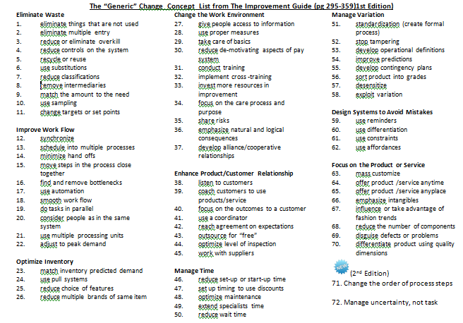
The “Generic” Change Concept List
The Improvement Guide (pg 295-359)1st Edition Plus 2 New Ones

Slide 63
Tip #5: Appropriate Scope for next PDSA Cycle
(concept developed by Lloyd Provost)
Staff Readiness to Make Change
Current Situation |  | Resistant | Indifferent | Ready
Low Confidence that current change idea will lead to Improvement | Cost of failure large | Very Small Scale Test | Very Small Scale Test | Very Small Scale Test
 | Cost of failure small | Very Small Scale Test | Very Small Scale Test | Small Scale Test
High Confidence that current change idea will lead to Improvement | Cost of failure large | Very Small Scale Test | Small Scale Test | Large Scale Test
 | Cost of failure small | Small Scale Test | Large Scale Test | Implement
Source: IHI and Lloyd Provost, Associates in Process Improvement
Notes:
Size

Slide 64
Twenty Questions for Process Analysis
Process Step | 1 | 2 | 3 | 4
 | Current Method | Reason | Better Way | Method Chosen | Overall Improvement
PURPOSE (What?) | What happens? | Why do it? | What else could we do? | What should we do? | What is the overall improvement?
PLACE (Where?) | Where is it done? | Why do it there? | Where else could we do it? | Where should it be done?
TIME (When?) | When is it done? | Why do it then? | When else could we do it? | When should it be done?
PERSON (Who?) | Who does it? | Why them? | Who else could do it? | Who should do it?
PROCEDURE (How?) | How is it done? | Why do it this way? | What other way could we do it? | How should it be done?
Notes:
Can be used as a less intimidating alternative to FMEA
Breaks the “That’s how we’ve always done it” mindset.
Challenges the assumptions about how processes work.
Start with current method and ask “What, Where, When, Who, and How.”
Ask reason.
List alternatives under “Better Way.”
Decide about improvements to make under “Method Chosen"
Chop off ¼ of turkey story

